Slide 1
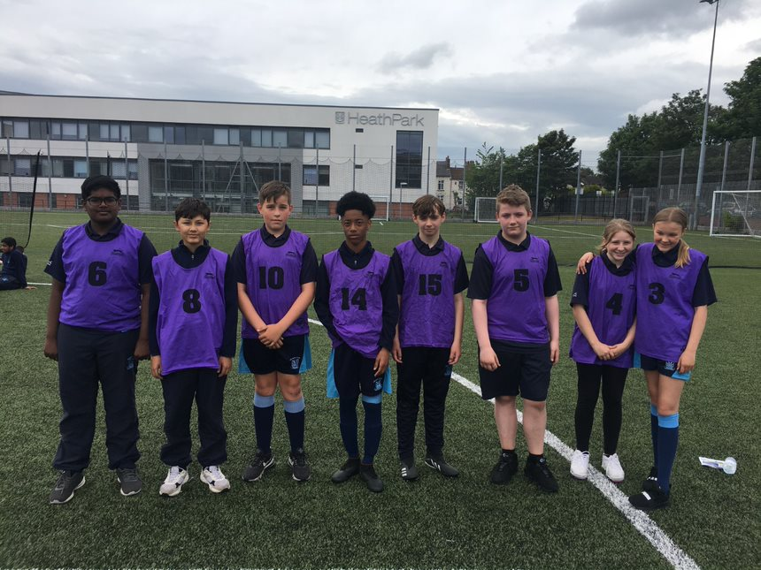
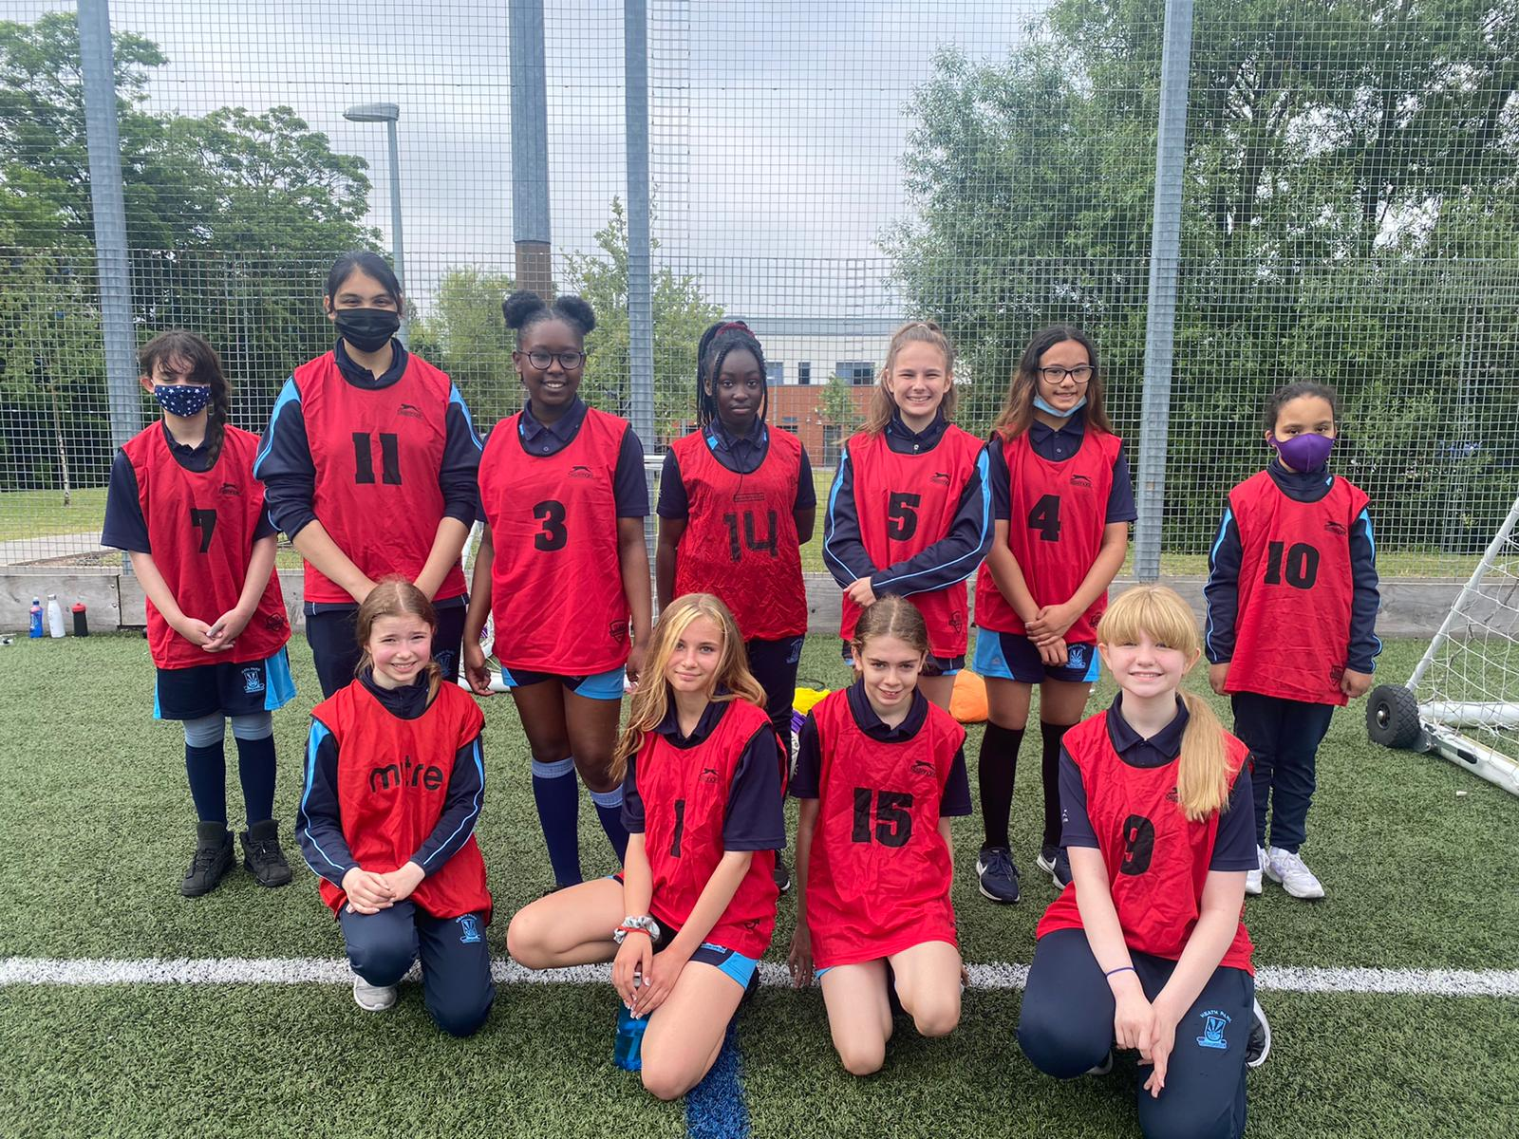
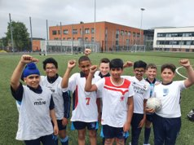
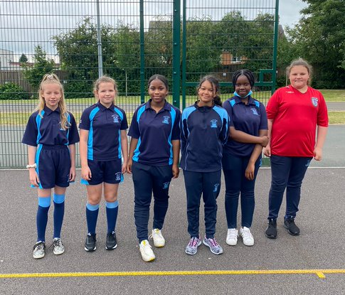
Congratulations to Heath Park
Football Euro Winners
Y8 X Girls | Spain
Y8 Y Girls | Spain
Y8 X Boys | England
Y8 Y Boys | Belgium
Y9 X Band | Sweden
Y9 Y Band | Belgium
Y10 X Band | Italy
Y10 Y Band | Italy
Y11 X Band | Netherlands
Y11 Y Band | England

Slide 2
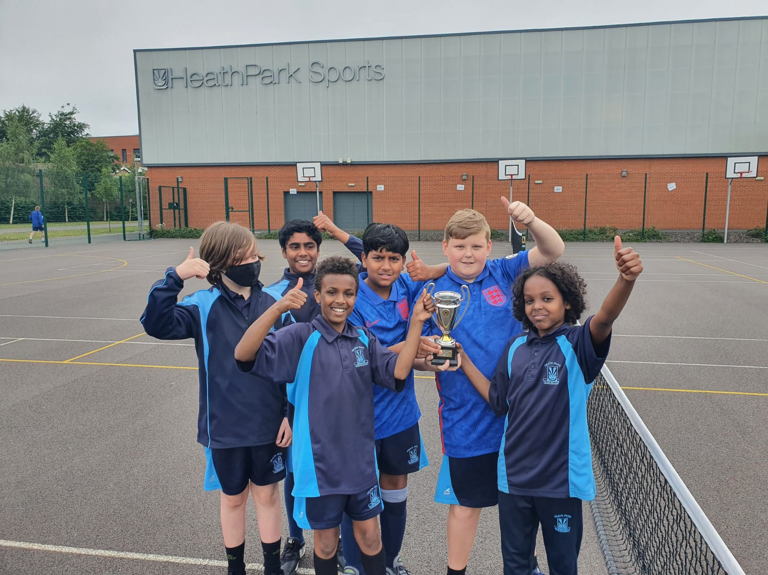
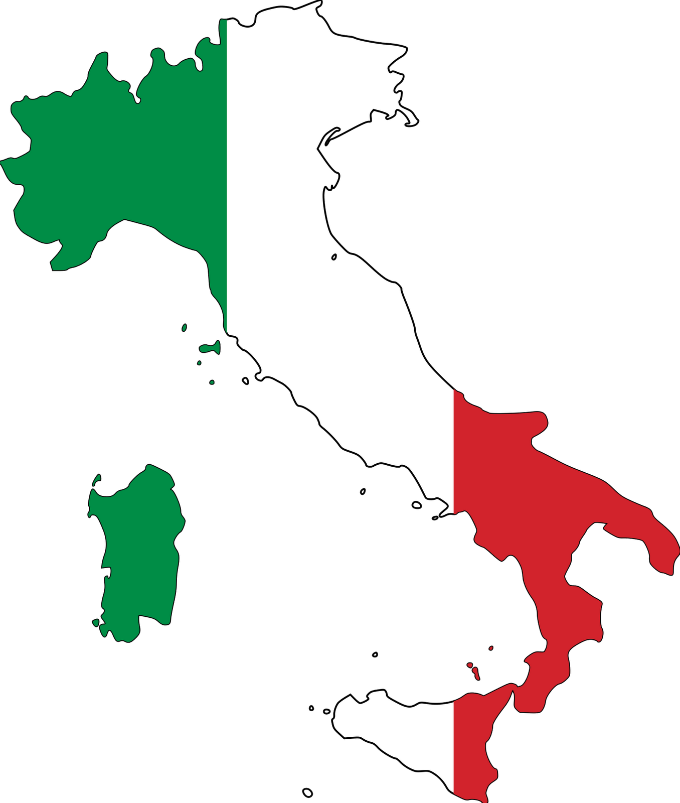
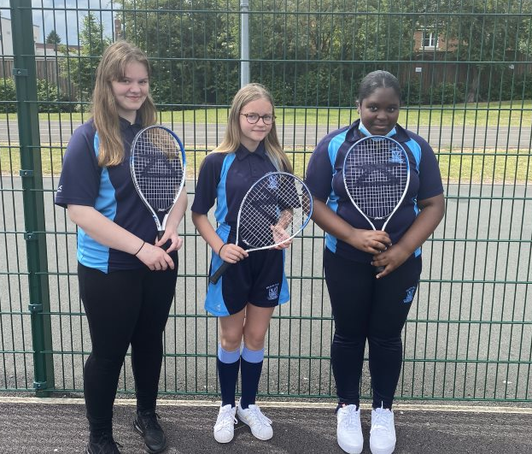
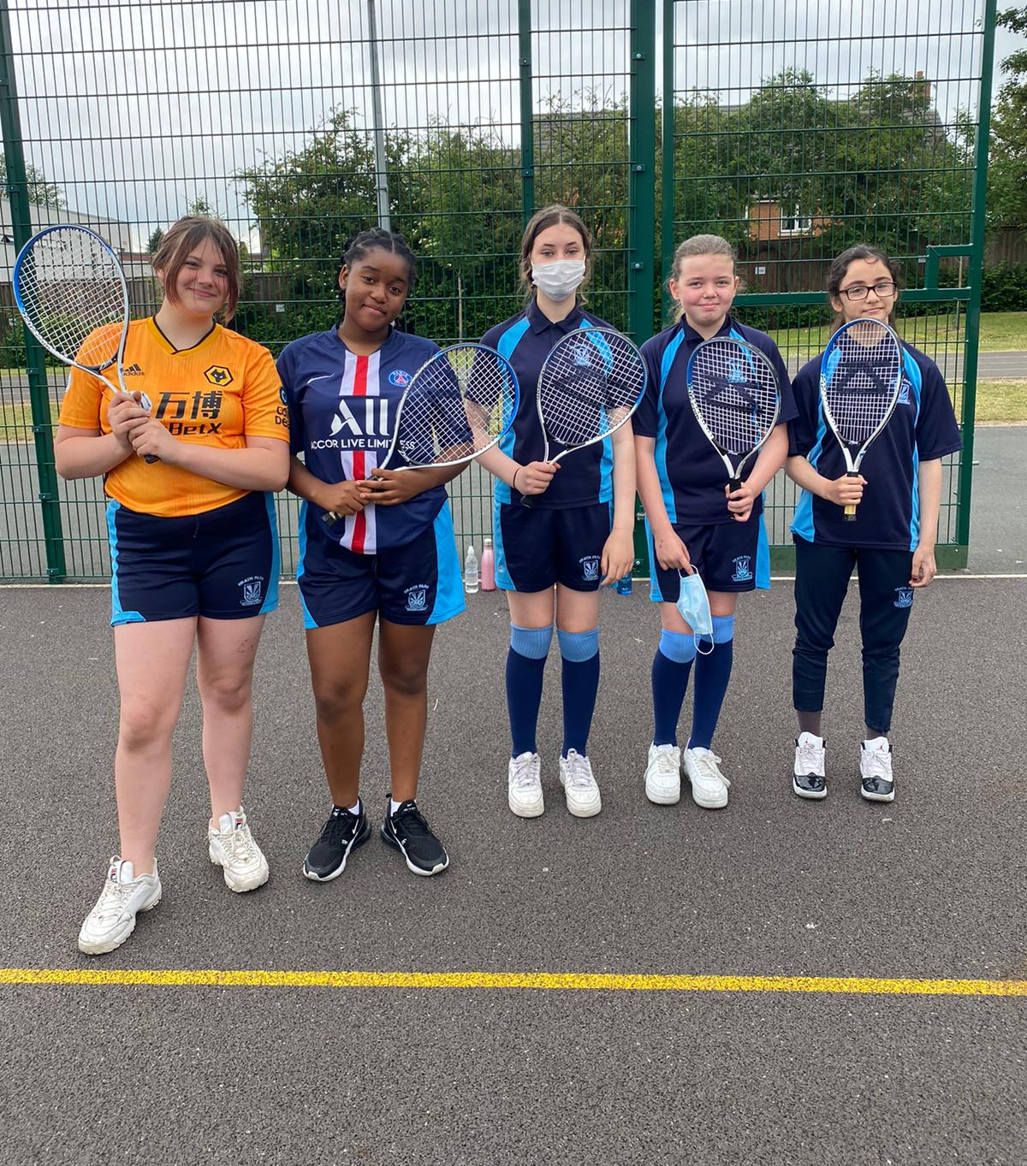
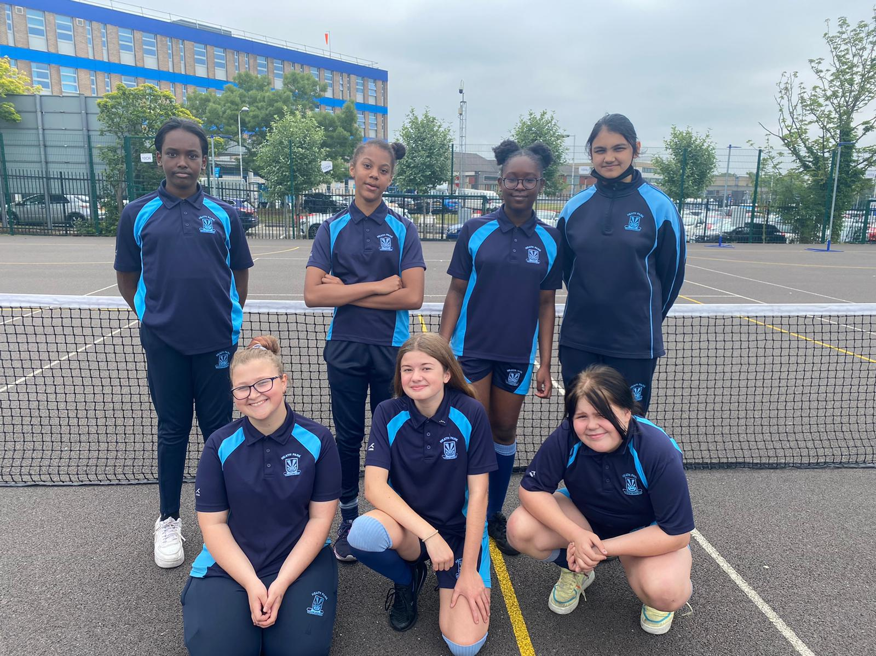
Congratulations to our Heath Park
Tennis Euro Winners
Y8 X Girls | Sweden
Y8 Y Girls | France
Y8 X Boys | Italy
Y8 Y Boys | Spain
Y9 X Band | Spain
Y9 Y Band | Portugal
Y10 X Band | Belgium
Y10 Y Band | England
Y11 X Band | Italy
Y11 Y Band | Russia

