Slide 1

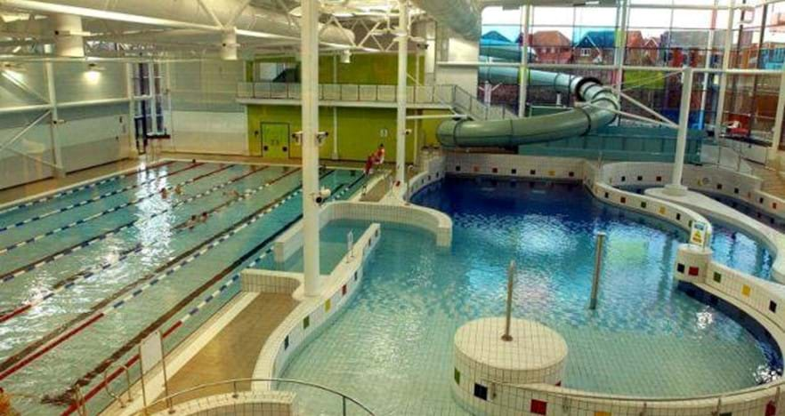
Free Swimming Card - Bentley Bridge
If you are 8-15 years old and live in Wolverhampton you can apply for a free swimming card.
This will allow you to swim for free of charge during any public swimming times at Bentley Bridge.
Please ask parents to complete the following form and take a council tax bill into Bentley Bridge Swimming and Fitness Centre to receive your card.
Any questions please ask a member of the PE department.

