Slide 1
CENTRAL SIXTH FOOTBALL ACADEMY
Academic Year 2023-24

Slide 2
PROVISION
Open to all current Y11 and 12 Girls and Boys
5 hours+ football training/matches per week, held on HP 4G
Participate in AOC regional and national leagues and national knockout cups
English Schools National Cup
Receive top quality coaching from fully qualified coaches outfield and GK (UEFA B, C)
You will complete alongside BTEC National qualification in Sport (single, double or triple award) or combine with other BTEC/A Levels
No negative impact on academic studies (out of lesson time)
Links with professional clubs e.g. Walsall FC, WWFC and Kidderminster Harriers FC
Links to Universities- University of Wolverhampton, BCU and UoB
Coaching/ Leadership opportunities to enhance UCAS applications
Additional opportunities
Aspire to HE trips e.g. Physiotherapy, Business of football discovery, Sport Leadership
FA Intro to football coaching (Level 1)
FA Level 1 Officiating
EE Playmaker by England Football
Disability Football Introduction
Introduction to Futsal
Safeguarding For All
Introduction to Talent Identification
Introduction to First Aid in Football
Sudden Cardiac Arrest Course

Slide 3
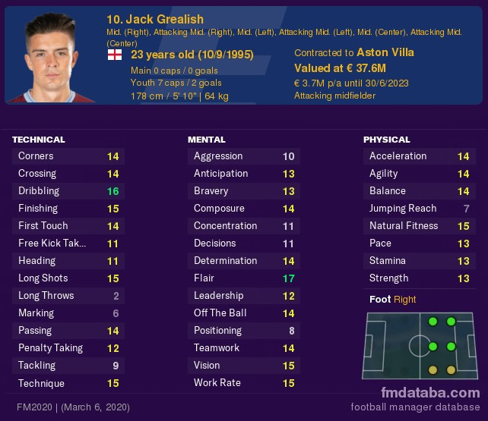
PLAYER PROFILING
Performance profiling is an effective method of enriching an individual’s physical, psychological and technical skill development. Players will have regular targets set according to their profile which looks at the 4-corner player model:
Technical/Tactical
Physical
Social
Psychological
Each area will be based upon training/game performances and discussions will help model individual learning plans to help guide improvements in player performance. Training sessions will be linked to the ILP's and other analysis materials.
Testing carried out Start, Middle and End of season

Slide 4
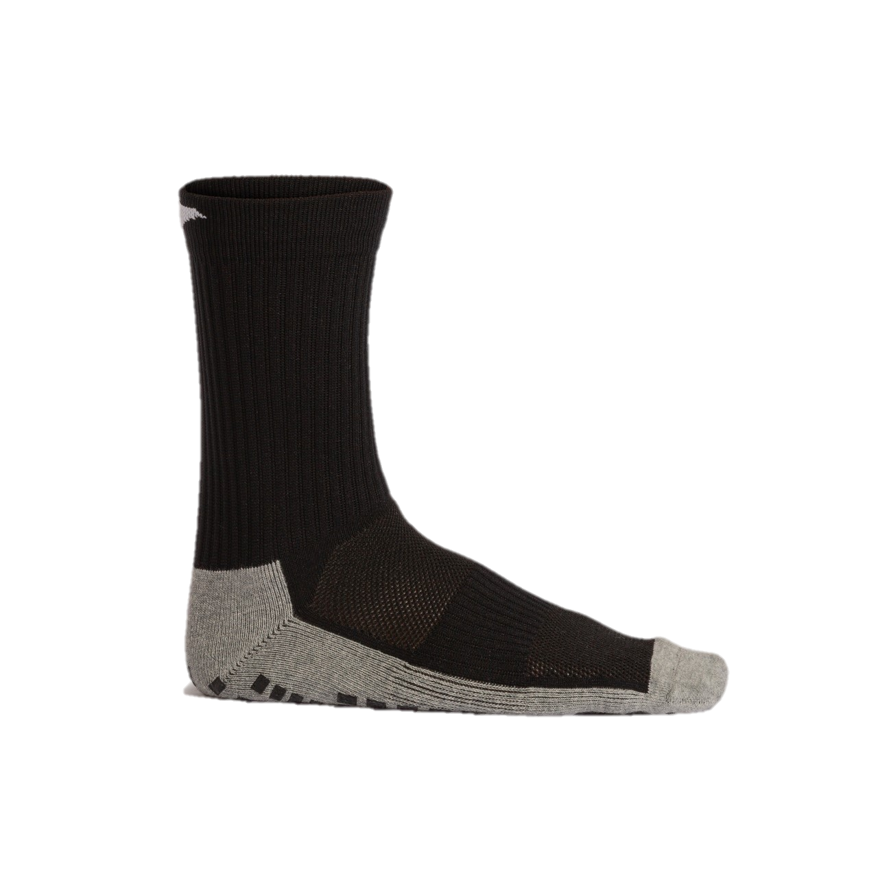
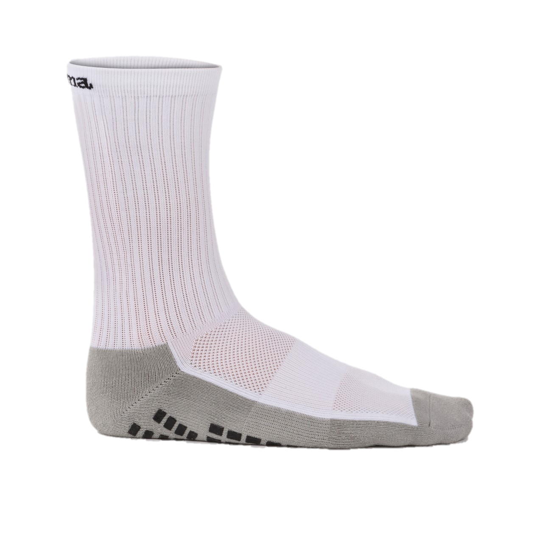
FOOTBALL ACADEMY KIT

Slide 5
To sign up please email gg@heathpark.net

